Slide 1
Directions NA 2023 Microsoft presents: Troubleshooting performance in Business Central Online

Slide 2
Abstract
Hidden
Not a single conversation we have with you goes without mentioning service performance. “How good is it? Can it handle my scenarios? How do I know where to look (or whom to blame?), if performance is having a “bad day”?” We know how important it is to your day-to-day work, so release after release, we work on making every service component faster, tuning critical scenarios and also adding tools for you to be efficient in troubleshooting performance. We are eager to share with you how far we have taken our service and tooling in terms of ability to troubleshoot performance issues.

Slide 3
Agenda
Introduction
Profiling code performance in live environments
Testing performance with the Business Central Performance Toolkit
Analyzing performance with telemetry
A generic performance tuning process
Q&A

Slide 4
Performance is not just something that you think about if there are issues…

Slide 5
Performance Activities In every phase of the project
Load Simulation
(BCPT)
Profiling
(AL Profiler)
Customization Impact
(BCPT)
Telemetry Monitoring
(PowerBI App)
Customer Profiling
(In-Client Profiler)
Acceptance Test
(BCPT)
Regression Detection
(BCPT)
Planning
Development
Test
Deployment
Operations
Maintenance
Planning
Development
Test
Deployment
Operations
Maintenance
Canceling Sessions
(TAC)
Resolving Database Locks
(Database Locks Page)

Slide 6
Profiling code performance in live environments

Slide 7

Profiling Code Perfomance
Profiling is used to determine where the time is spent for a particular scenario
In-Client Profiler
Embedded in the Client UI
Can be used by the Customer
Can determine where to start
AL Profiler
Developer Tool in VS Code
More detailed information about the code execution

Slide 8
In-Client Profiler
Demo

Slide 9
Testing performance with the Business Central Performance Toolkit (BCPT)

Slide 10

Business Central Performance Toolkit (BCPT)
It’s a Toolkit, expect more tools in the future…
Multi-user Benchmark Tool
Simulate multiple users running simultaneously
Measure Performance
Detect Locking Issues
Test usage on a “system under load”
Ideas for Future Tools
Single User Performance Measurement
Performance Regression Detection
Performance Limit Testing
Performance Stress Testing

Slide 11
Business Central Performance Toolkit (BCPT)
Demo

Slide 12
Analyzing performance with telemetry

Slide 13
As a support engineer, I would like to…
… use data to analyze performance issues for customers
… have an easy way to spot performance bottlenecks

Slide 14
Demo
Power BI app on Business Central performance – the quick tour for VARs

Slide 15
As a developer, I would like to…
… use data to analyze performance issues in my apps
… have an easy way to spot performance bottlenecks

Slide 16
Demo
Power BI app on Business Central performance – the quick tour for ISVs

Slide 17
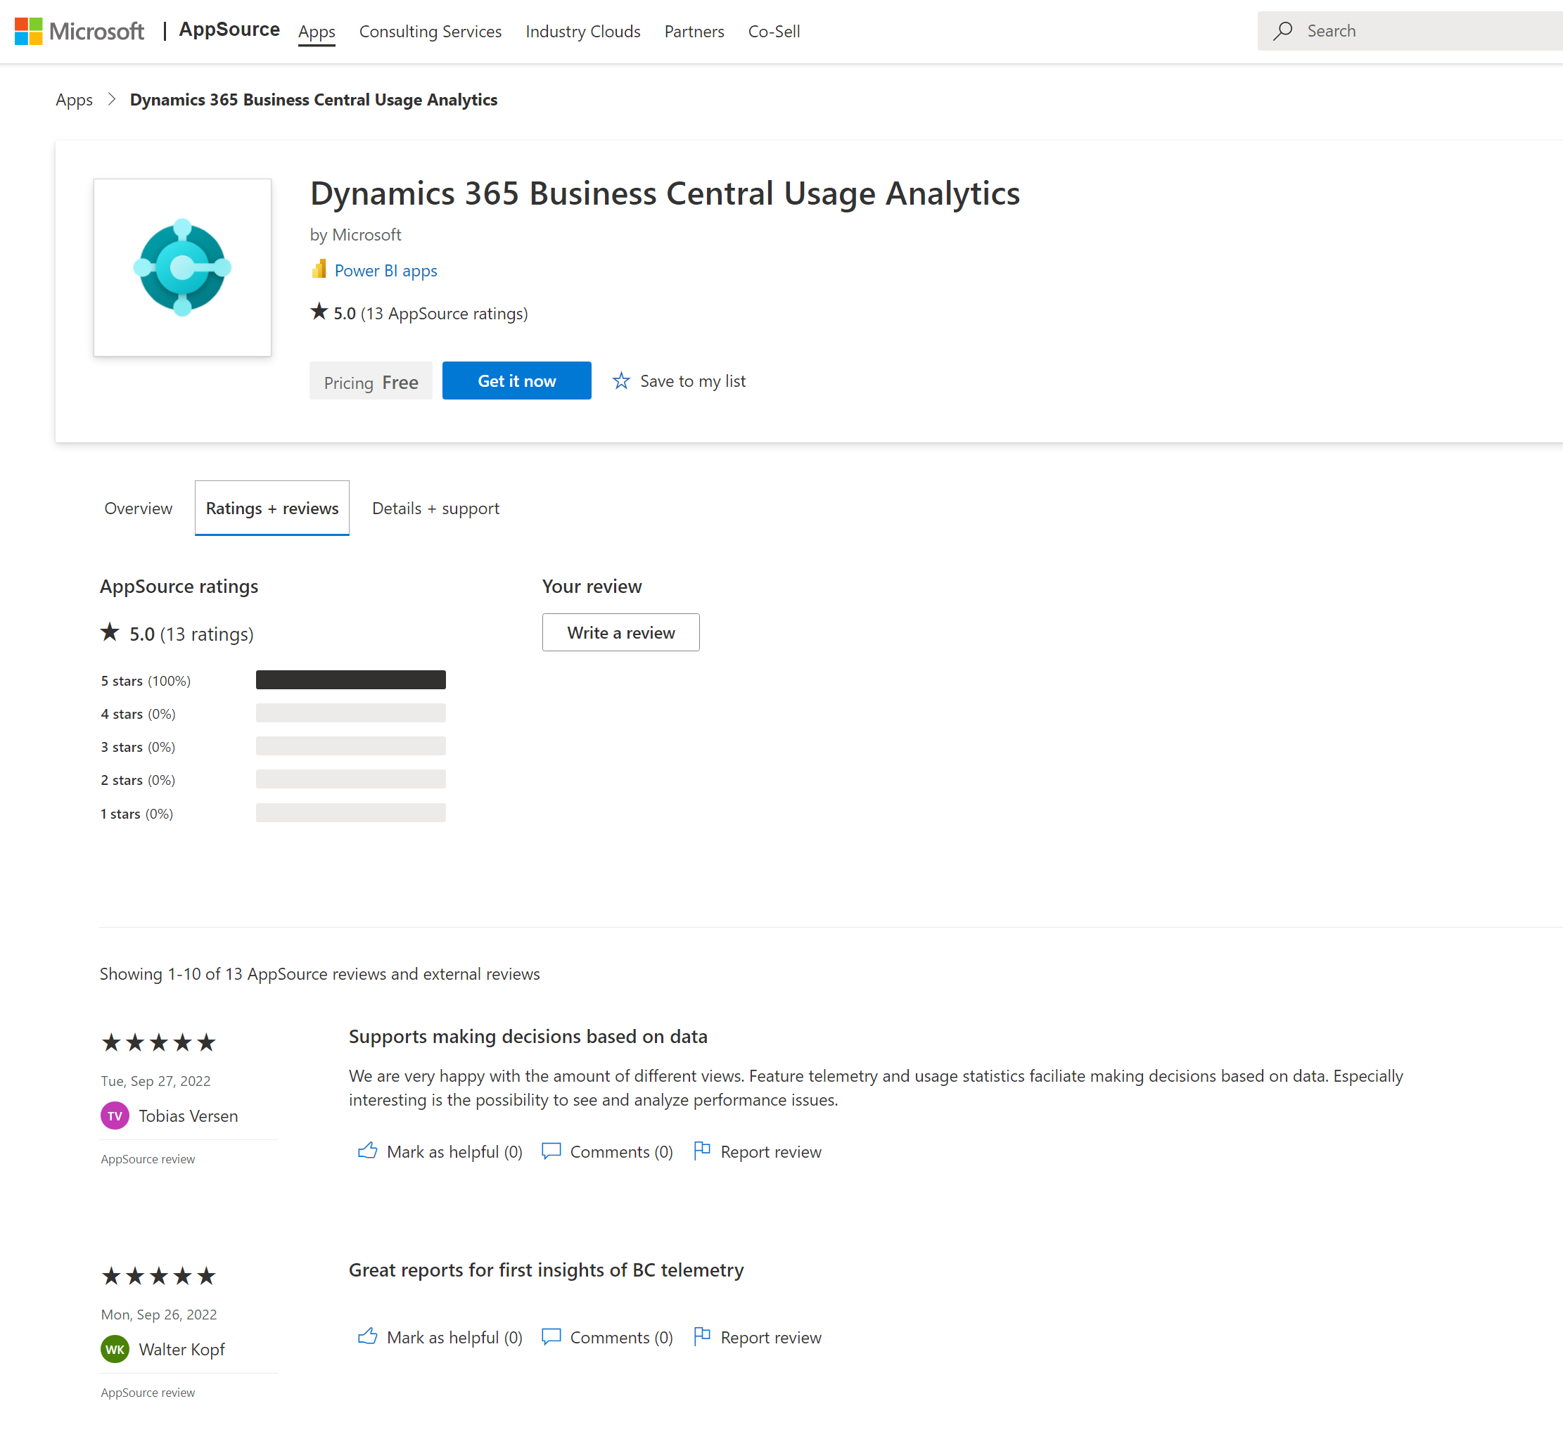
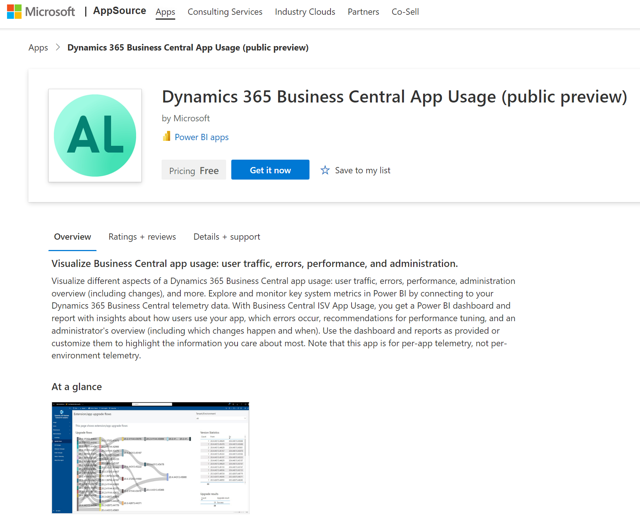
Power BI apps on telemetry
For VARs
For ISVs
https://aka.ms/bctelemetryreport
https://aka.ms/bctelemetry-isv-app

Slide 18
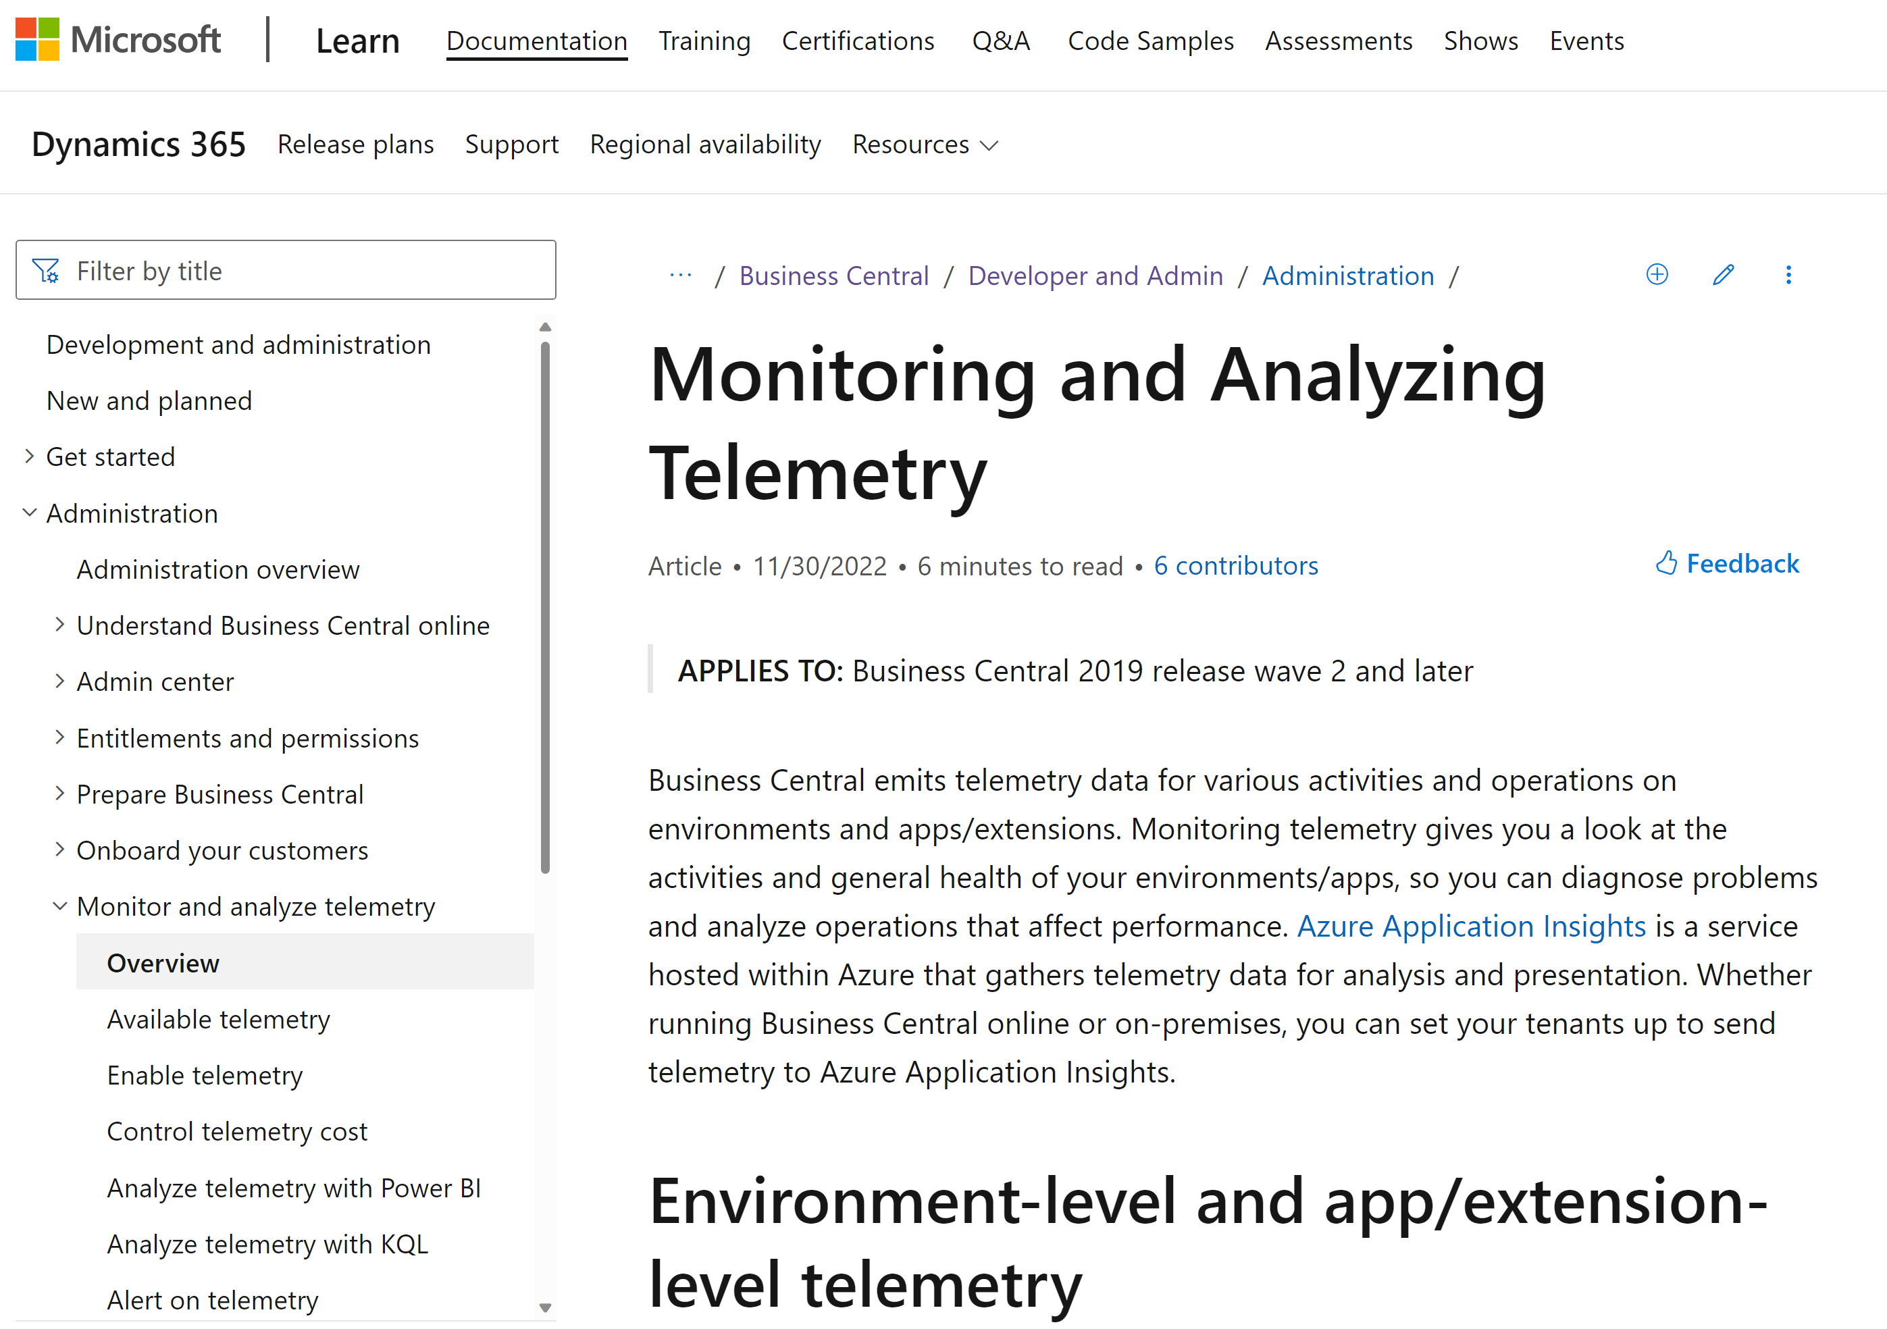
aka.ms/bctelemetry

Slide 19
A generic performance tuning process

Slide 20
Generic performance tuning process
First define “slow” with the customer.
Now do iterations of the following tasks:
Measure system performance and collecting performance data
Locate a bottleneck
Eliminate the bottleneck
Continue until the "slow" operations are comparable to the established baseline.

Slide 21
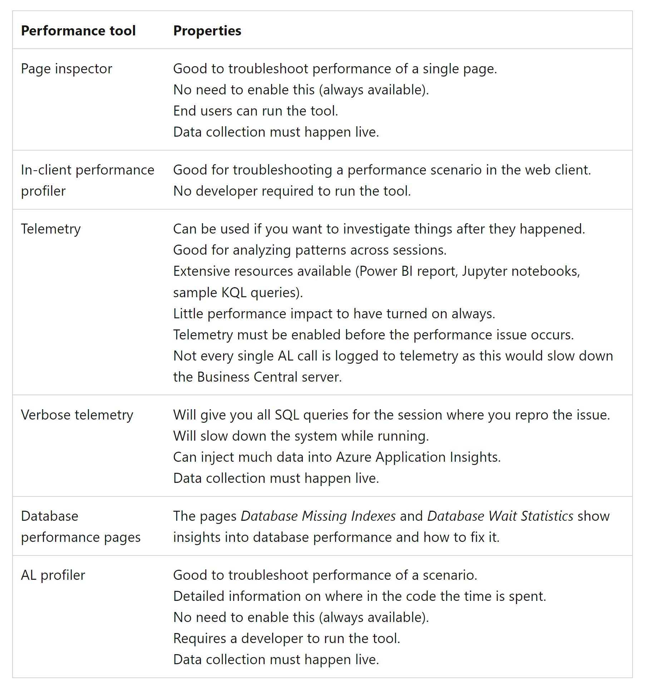
Performance tools When to use what

Slide 22
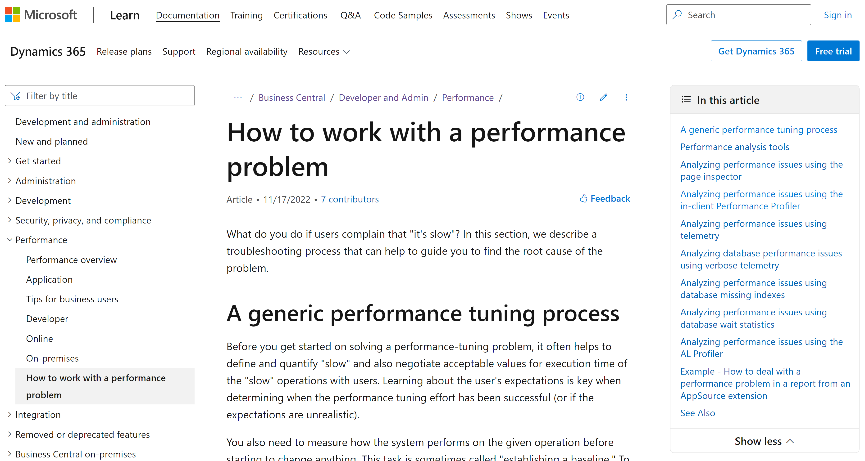
aka.ms/bcperformance (process and all tools)

Slide 23
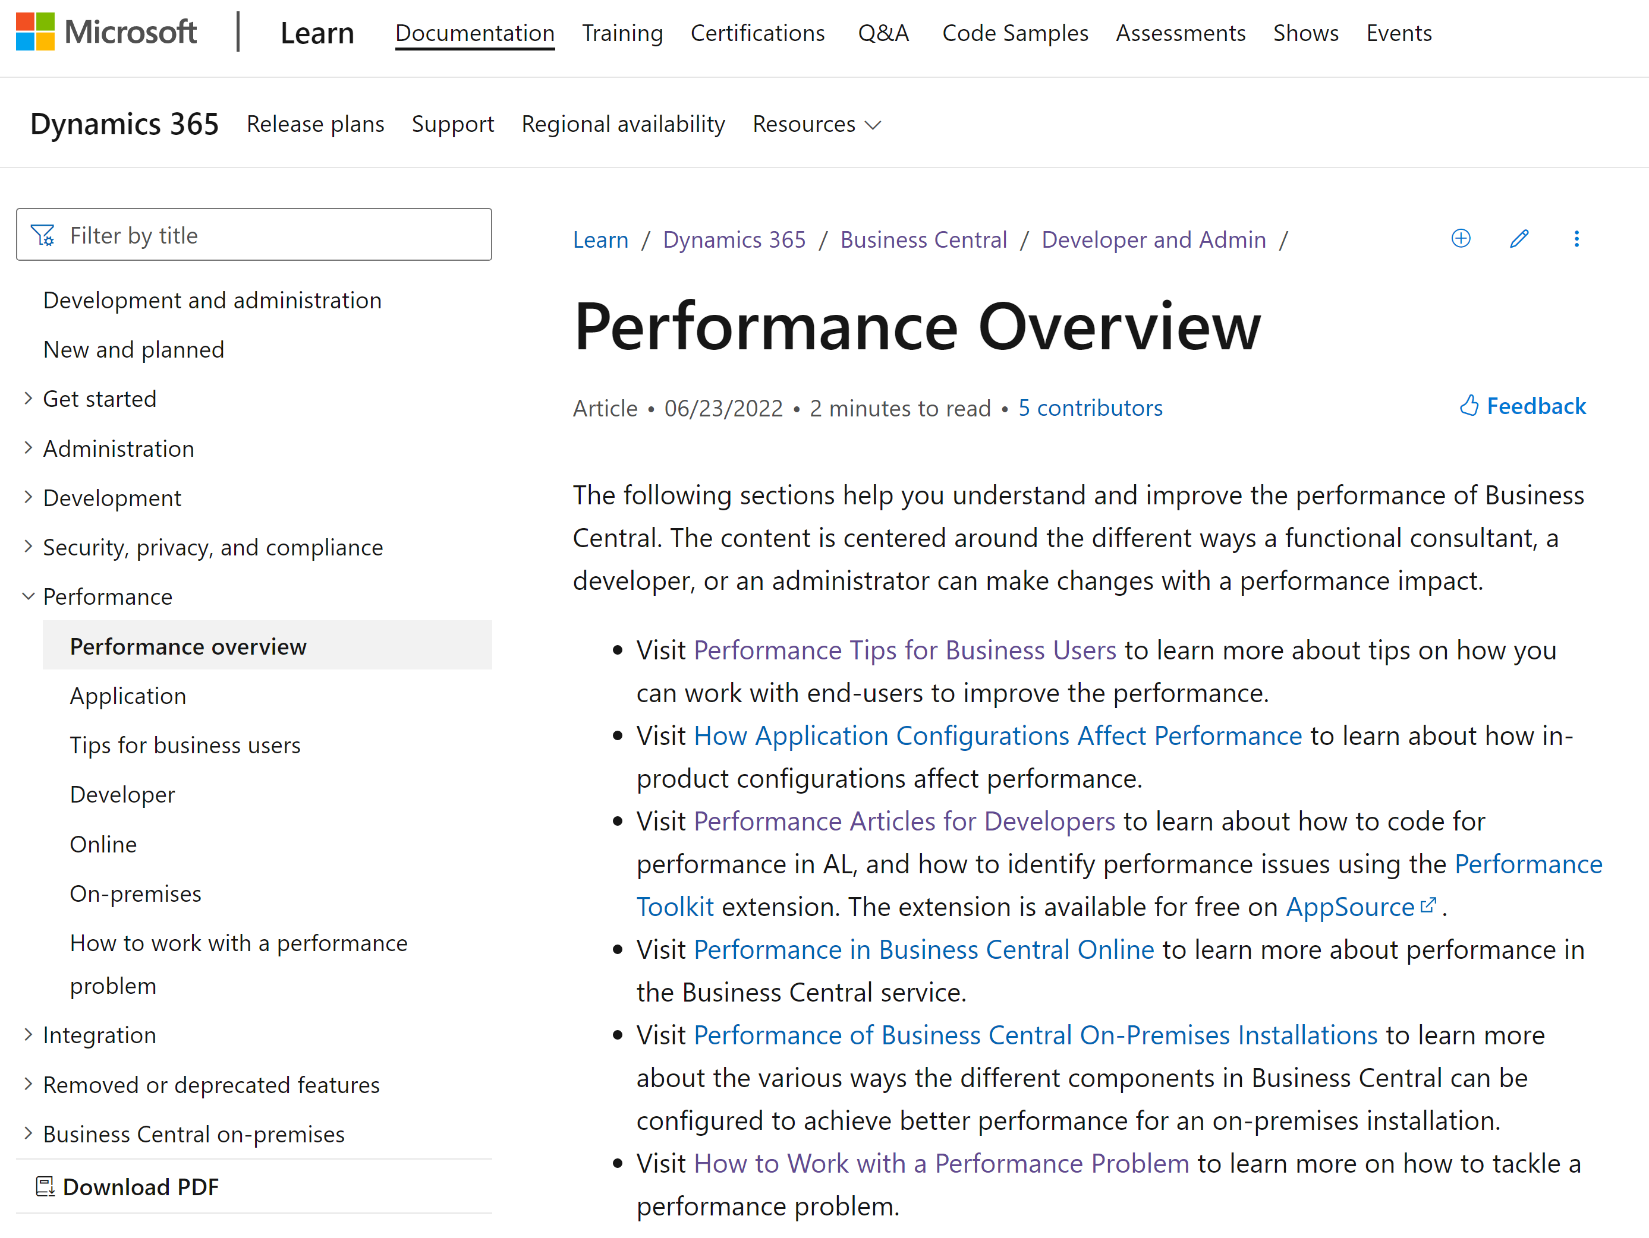
aka.ms/bcperformance

Slide 24
Go-dos
Setup and use BCPT
Learn to use the profiler
Enable telemetry and analyze performance
Read the docs
aka.ms/bcperformance

